Slide 1

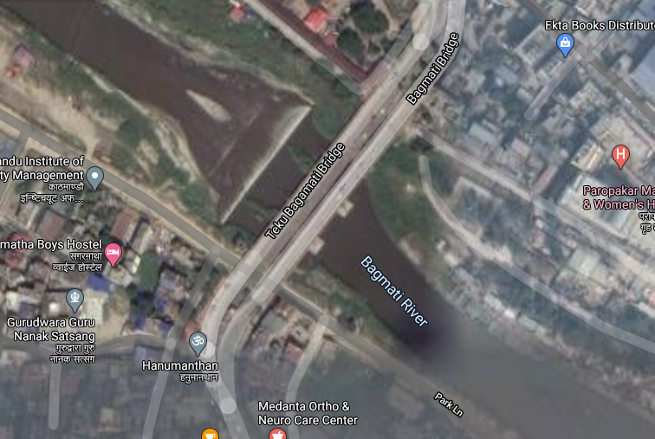
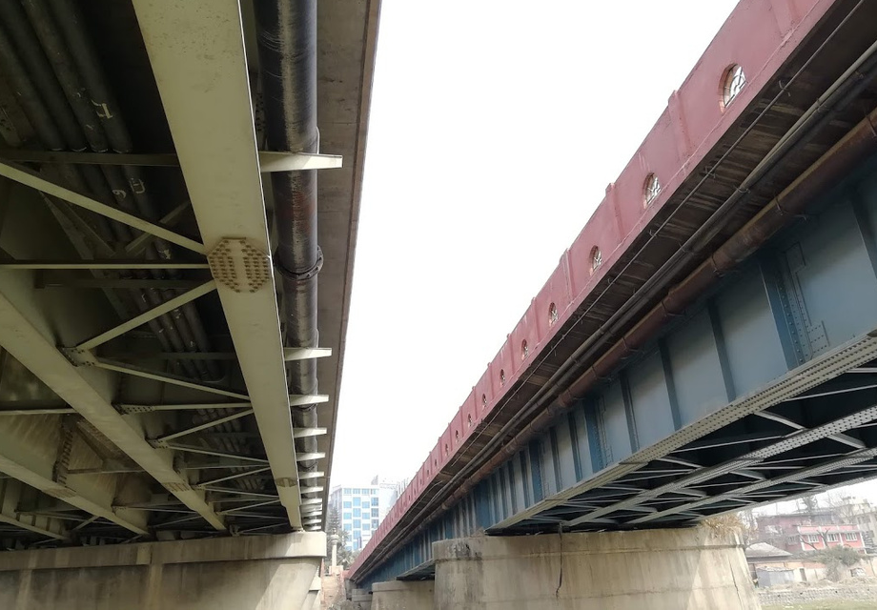
A System Of Vehicular Motion Sensing and Impact Analyst
By:
Amit Paudyal, Nabin Rai, Nirdesh Bhattarai and
Shiva Bhandari
Supervised by: Assoc. Prof. Dr. Nanda Bikram Adhikari
Department of Electronics and Computer Engineering, Pulchowk Campus

Slide 2
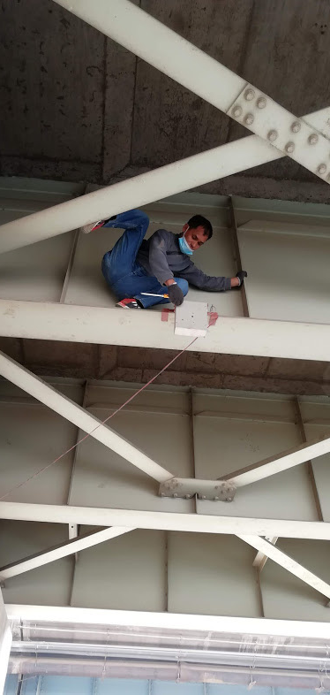
Introduction
Background and Problem Statement
Bridges and Road Transport
Structural Integrity of Bridge and its Importance
Kathmandu Valley and Heavy Traffic
Objectives
To Design a Structural Health Monitoring System
To Design a Data Acquisition System
To Perform Analysis on the Data

Slide 3
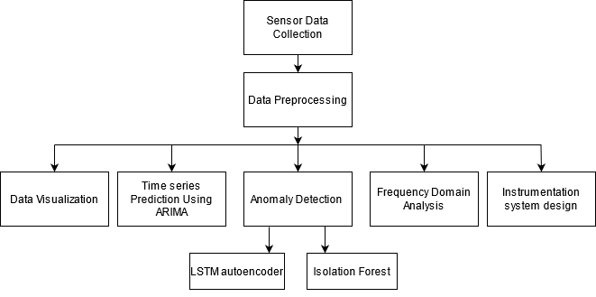
System Block Diagram

Slide 4

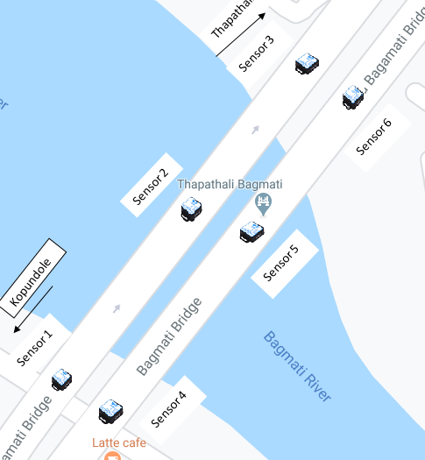
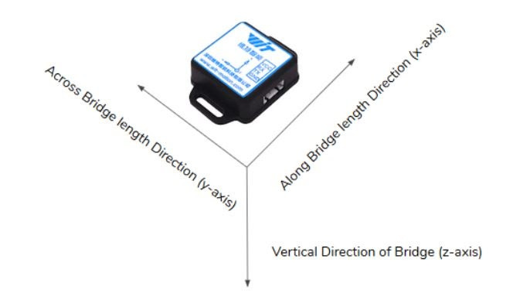
Sensor
Sensor Module: Inertial Measurement Unit (IMU)
Data retrieval: Via SD card, Data Acquisition
System (Proposed)
Variable Under Observation: Acceleration

Slide 5
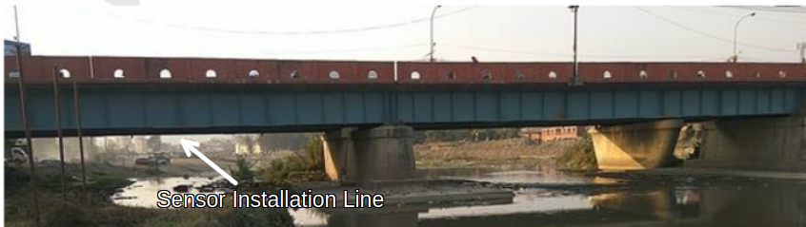
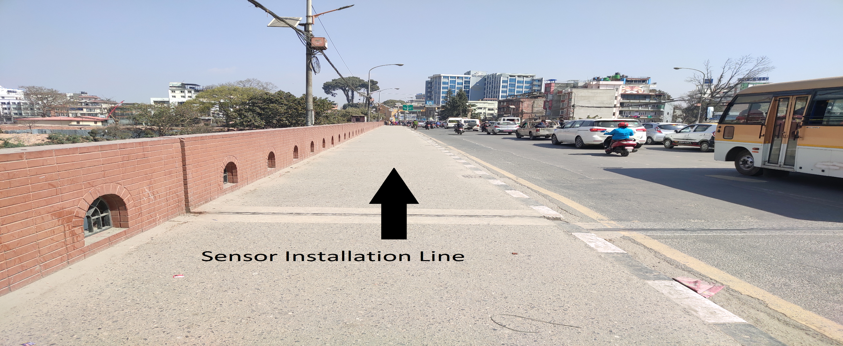
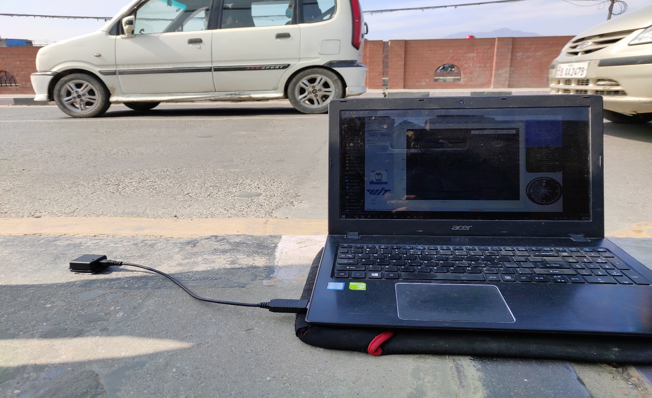
Sensor Data Collection
Case 1
Case1: Sensors Placed Under the Bridge
Case 2: Sensors Placed on the
Surface of the Bridge
Case 2

Slide 6
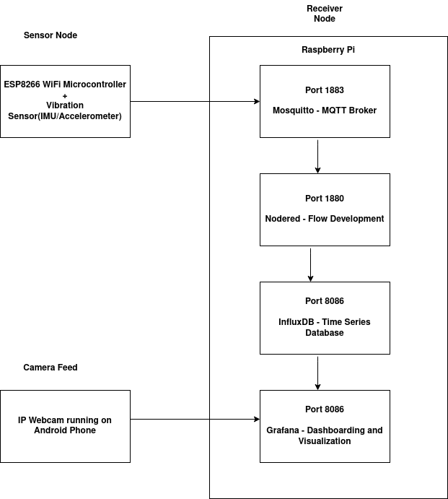
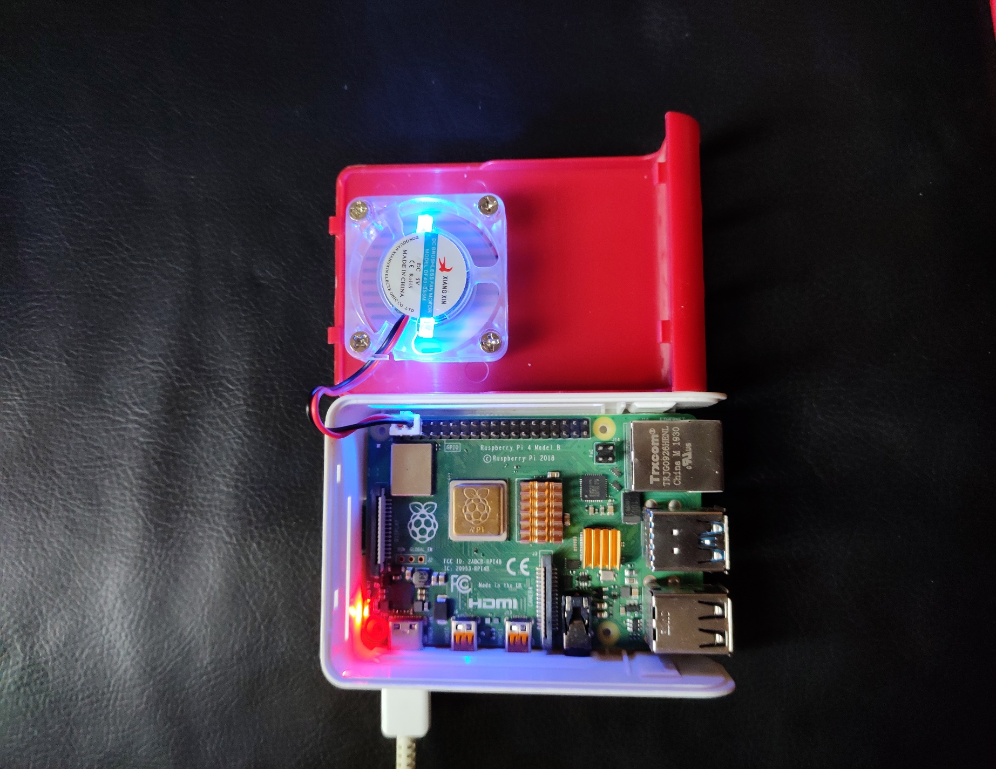
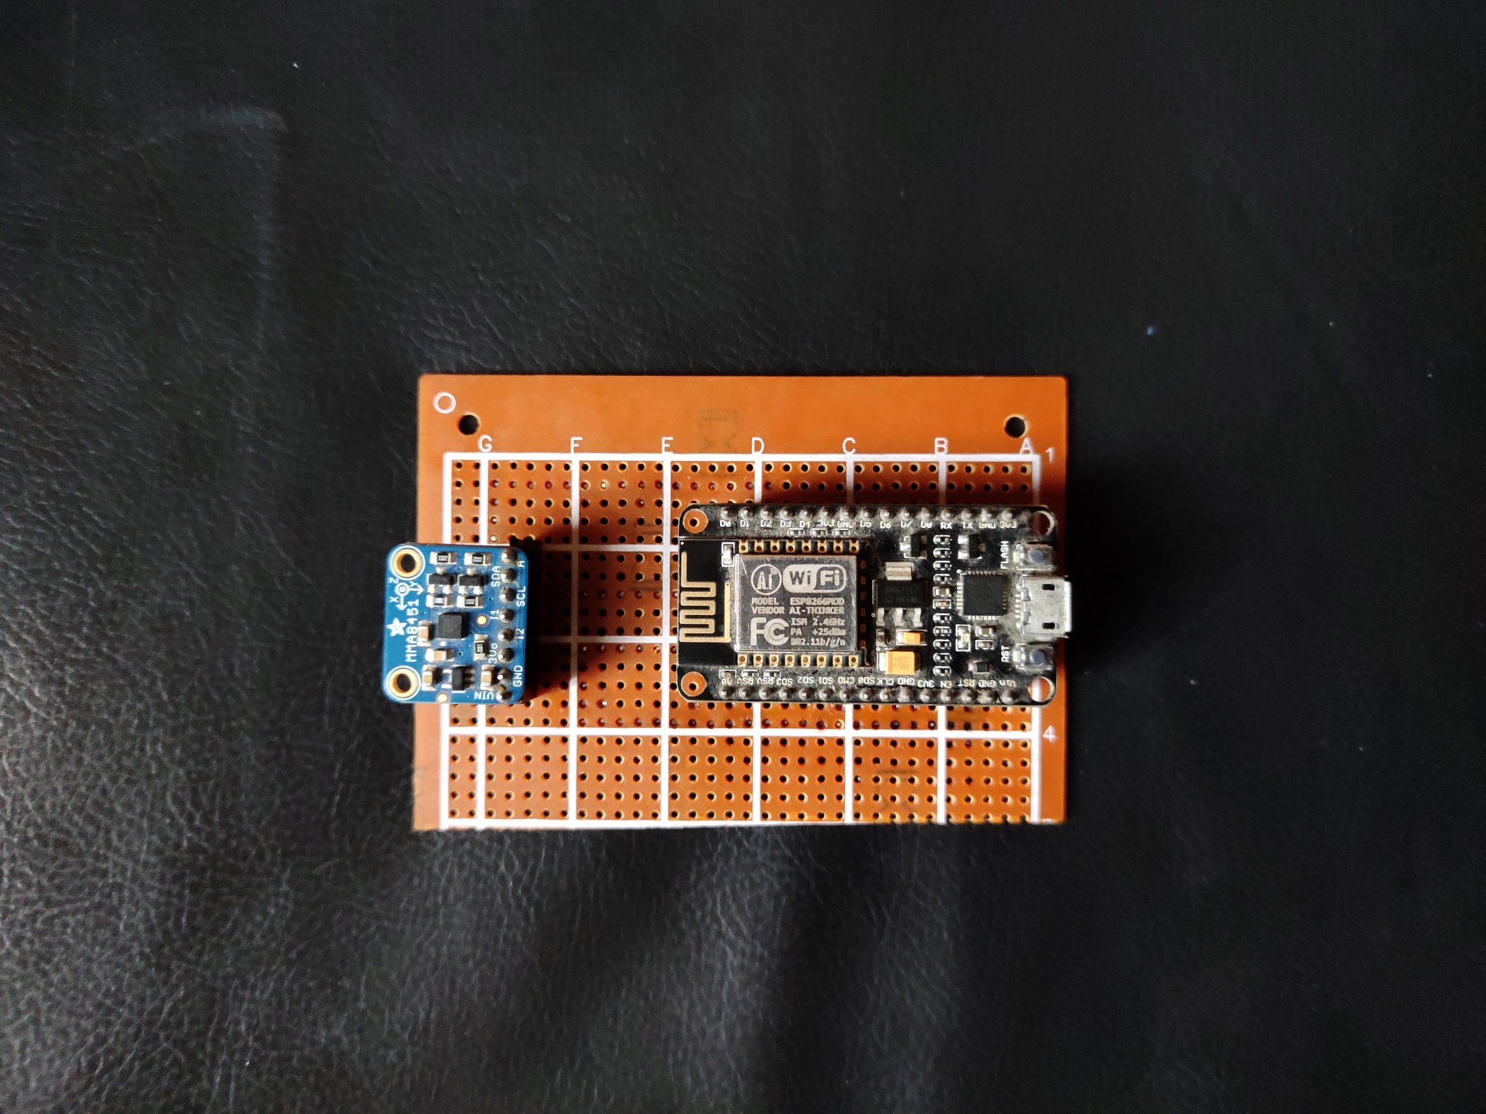
Data Acquisition System

Slide 7
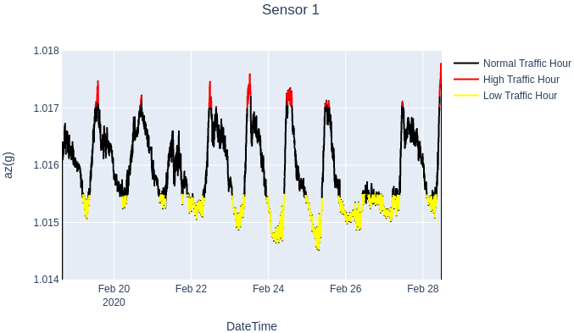
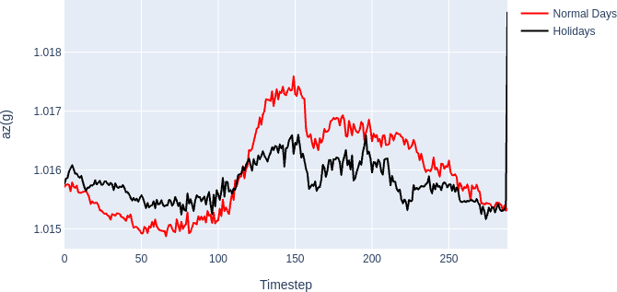
Analysis
of
Vehicular
Motion Case 1

Slide 8
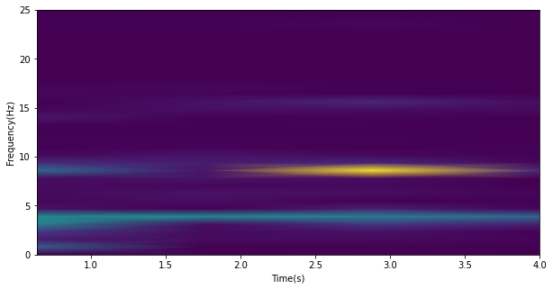
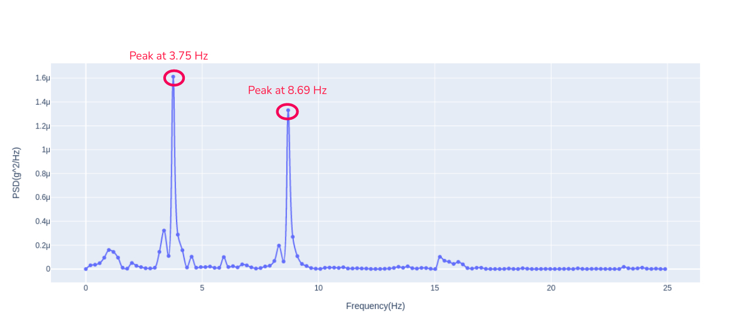
Frequency Domain Analysis
Three cases: no load condition, passing of a medium sized vehicle like sedans and SUVs, and the passing of a large sized vehicle like buses and RCC trucks.
Rolling mean---->High Pass Filtering(Cutoff frequency 1Hz)----> FFT calculation---->PSD calculation
Spectrogram of Large Vehicle Passing
PSD plot of Large vehicle passing

Slide 9
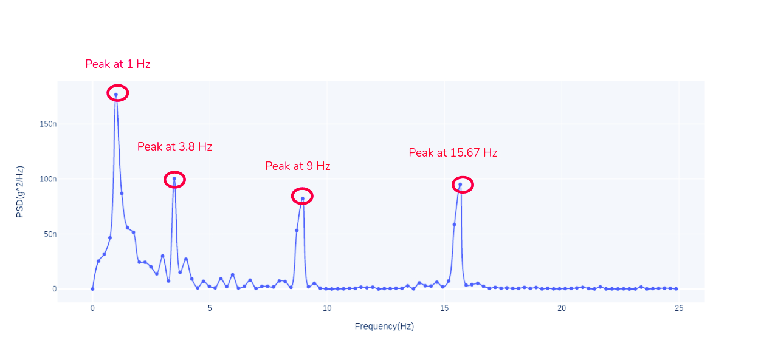
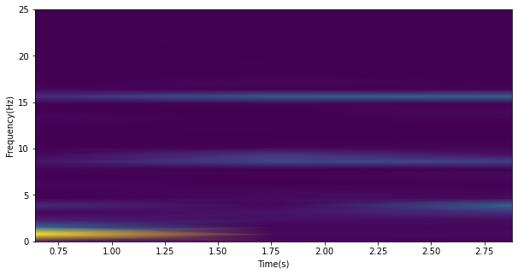
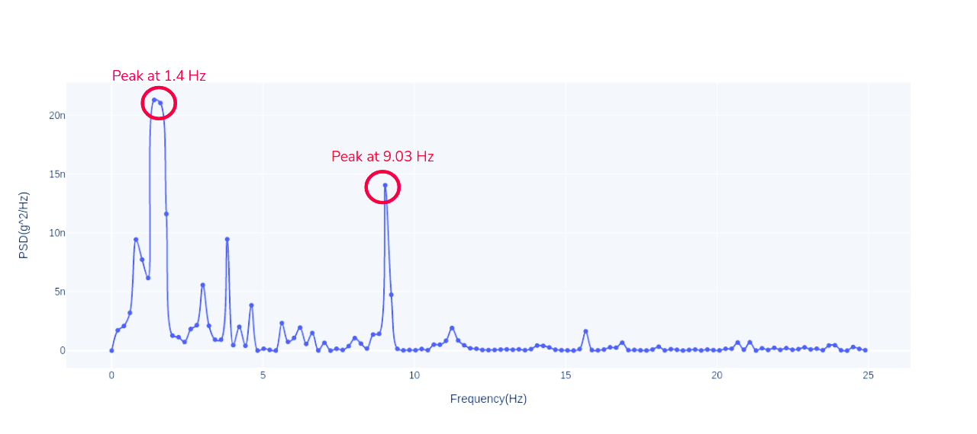
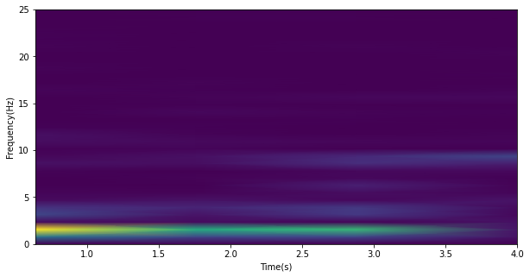
Frequency Domain Analysis Continued
PSD of medium sized vehicle
Spectrogram of medium sized vehicle
PSD of no vehicle passing
Spectrogram of no vehicle passing

Slide 10
ARIMA (Auto Regressive Integrated Moving Average) MODEL
Dickey Fuller Test : p = 0.0296 (< 0.05), which indicates that the time series is stationary
Model parameters calculated using the auto_arima() function
Best values were determined on the basis of lowest AIC value

Slide 11
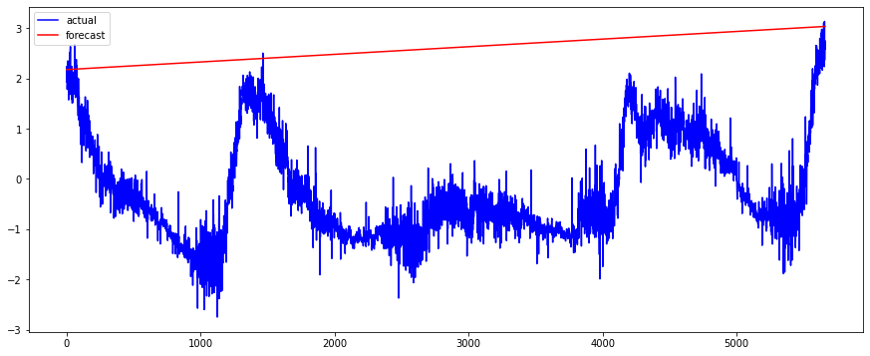
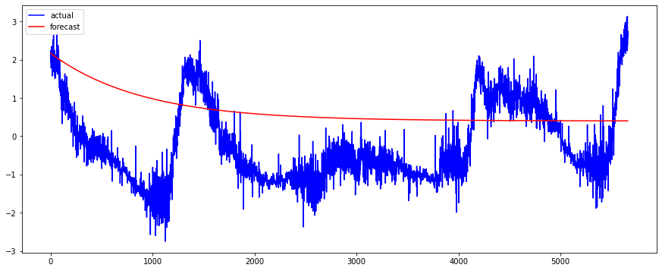
Results From Time Series Modelling Using ARIMA
ARIMA Model (2,1,1)
RMSE : 9.0676
ARIMA Model (3,0,1)
RMSE: 1.9159

Slide 12
ARIMA (Auto Regressive Integrated Moving Average) MODEL
Seasonal Modelling
Resampling of data to avoid large seasonal cycle factor
SARIMAX model fitted with the best model parameters derived from auto_arima

Slide 13
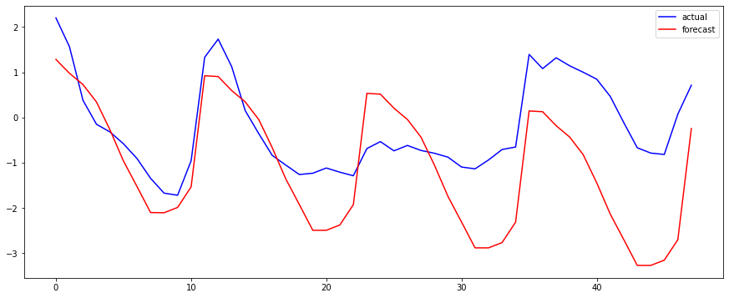
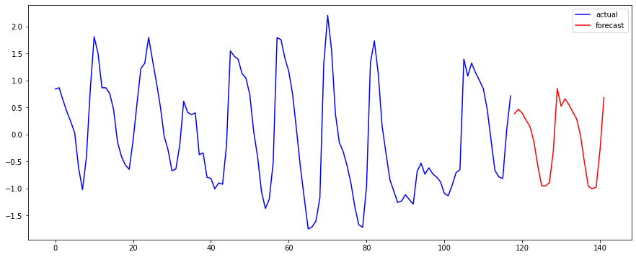
Seasonal ARIMA(0,1,1) MODEL
Seasonal ARIMA (0,1,1) (1,1,0,12) RMSE:1.80
Forecasting for the next two days using data from the last 10 days

Slide 14
Anomaly Detection
Special events detection in the bridge during vehicular movement
Maximum weight of vehicles
Maximum speed limit
Threshold for classifying events depends on both of the above
Noted down from vibration data.

Slide 15
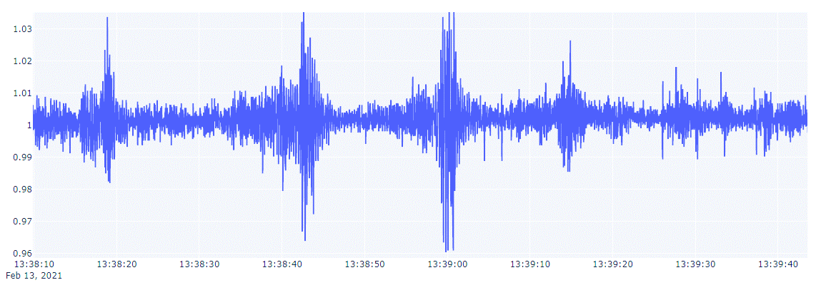
Analysis of Vehicular Motion for Case2
07
Time Stamp | Vehicle Passed
2021-02-13 13:38:18 | Water Tanker
2021-02-13 13:38:41 | Tipper
2021-02-13 13:38:59 | Tipper
2021-02-13 13:39:15 | Nepal Yatayat

Slide 16
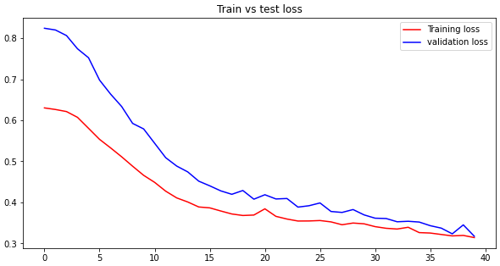
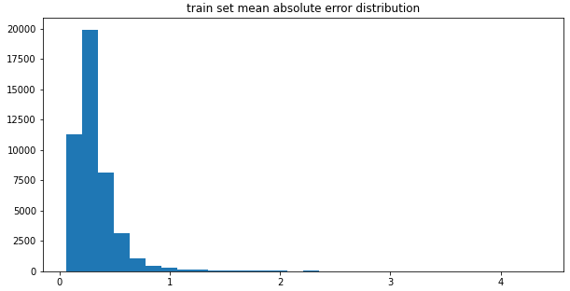
Anomaly Detection Using LSTM Autoencoder
Encoder Decoder Architecture: One LSTM encoder layer; dropout layer; repeat vector layer; drop out layer; time distributed layer
Hyperparameter tuning for finding best model
Reconstruction loss: Mean absolute error

Slide 17
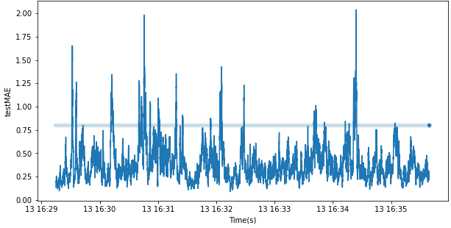
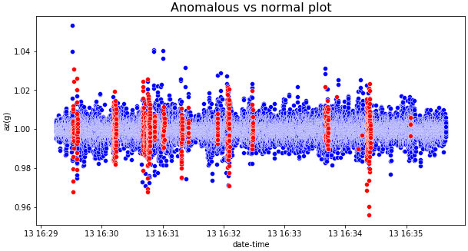
LSTM Autoencoder
Threshold selection for anomaly detection(from Train set MAE distribution plot)
Test loss >Threshold maximum Train loss =➔ Anomaly detected

Slide 18
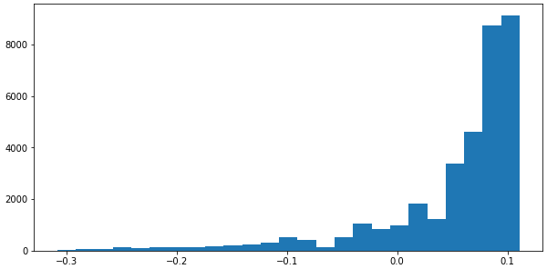
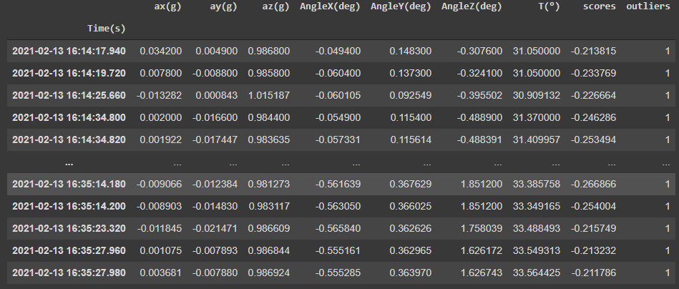
Anomaly Detection Using Isolation Forest
An ensemble of trees is build in train set
Hyper parameters: Contamination level, number of estimators(number of trees you want to build) and maximum sample
Training the iForest
Evaluating anomaly scores

Slide 19
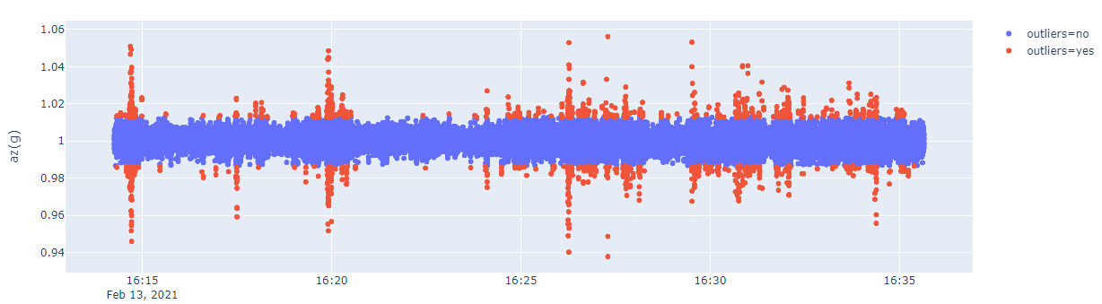
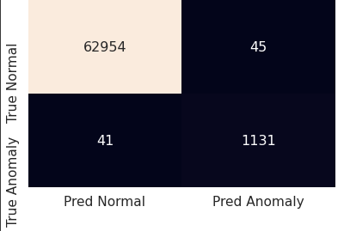
Results Anomaly Detection Using Isolation Forest
Threshold set by observing the anomaly score
Evaluating the model with respect to ground truth noted as follows
ROC AUC score: 0.98215, F1 score 0.96337

Slide 20
Conclusion
Study of vibration characteristics of structures like bridges is important for its condition monitoring and timely renovation.
Data driven modelling and analysis coupled with theoretical analysis can give a more accurate picture of conditions of structures.
Wireless sensor networks is an efficient method for structural health monitoring, understanding impacts of environmental and non environmental factors, and non destructive testing
Machine learning and statistical modelling is important for understanding events of interest and predicting future trends
Digital signal processing techniques like FFTs and spectrograms can provide insights about important features of structures.

Slide 21
Limitations
Frequent power failures and sensor failures in the experiment site leading to massive loss of data
Experimenting on some parts of the bridge was not possible because of difficulty of access
Date and time error occurs on the receiver node when it is not connected to the Internet
Lack of theoretical structural analysis leading to non verification of parameters like dominant frequencies
Insufficient time series data for better training of statistical and deep learning models

Slide 22
THANK YOU!!!!

